Slide 1
Exceptional Handling

Slide 2
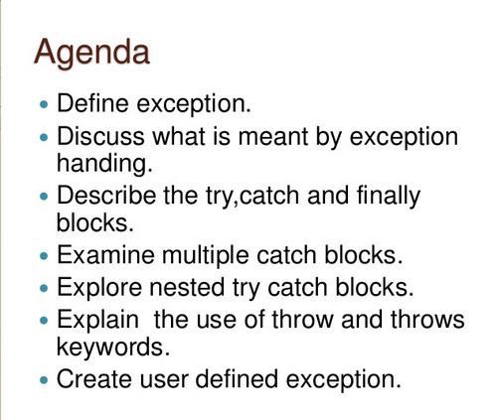

Slide 3

Is helmet required really???

Slide 4
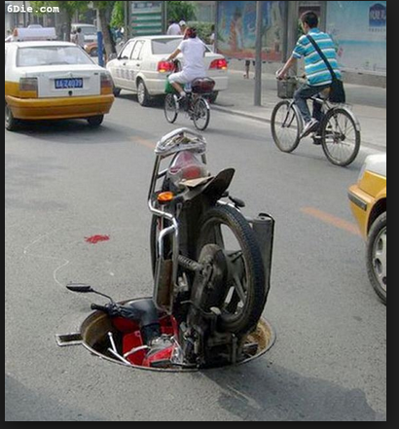
What Is an Exception?
An exception is an event that occurs during the execution of a program that disrupts the normal flow of instructions.

Slide 5
Why exceptions will occur
An exception can occur for many different reasons.
Examples:
Deviding a number by zero
A file that needs to be opened cannot be found.
A network connection has been lost in the middle of communications or the JVM has run out of memory.
Calling method on null object.
Inserting/fetching value with index which does not exist.

Slide 6
Why to handle exception?
If an exception is raised, which has not been handled by programmer then program execution can get terminated and system prints a non user friendly error message.

Slide 7
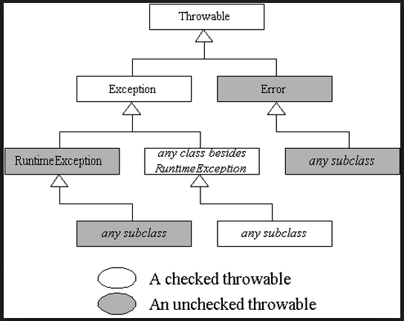
Class Hierarchy

Slide 8
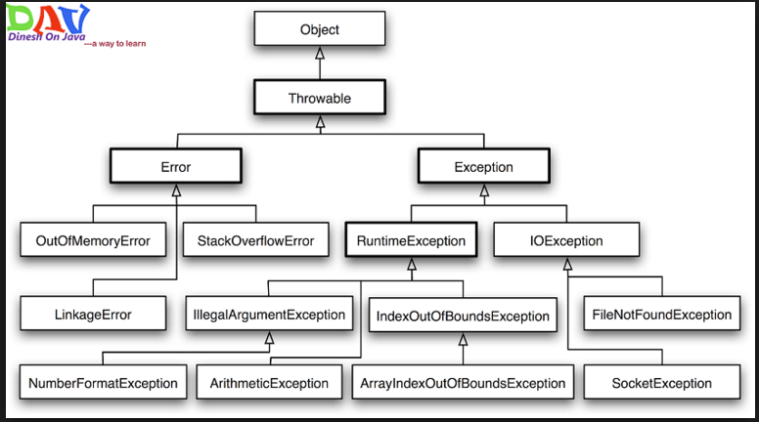

Slide 9
Methods of Throwable class
public String getMessage() – This method returns the message String of Throwable and the message can be provided while creating the exception through it’s constructor.
public String getLocalizedMessage() – This method is provided so that subclasses can override it to provide locale specific message to the calling program.
Throwable class implementation of this method simply use getMessage() method to return the exception message.

Slide 10
Methods of Throwable class
public synchronized Throwable getCause() – This method returns the cause of the exception or null id the cause is unknown.
public String toString() – This method returns the information about Throwable in String format, the returned String contains the name of Throwable class and localized message.
public void printStackTrace() – This method prints the stack trace information to the standard error stream, this method is overloaded and we can pass PrintStream or PrintWriter as argument to write the stack trace information to the file or stream.

Slide 11
Error
Errors: Errors are exceptional scenarios that are out of scope of application and it’s not possible to anticipate and recover from them, for example hardware failure, JVM crash or out of memory error.
That’s why we have a separate hierarchy of errors and we should not try to handle these situations.
Some of the common Errors are
OutOfMemoryError
and
StackOverflowError.

Slide 12
Checked Exception
Checked Exceptions are exceptional scenarios that we
can anticipate in a program
and
try to recover from it.
We should catch this exception and provide useful message to user and log it properly for debugging purpose.
Exception is the parent class of all Checked Exceptions.
If we are throwing a checked exception:
we must catch it in the same method
or
we have to propagate it to the caller using throws keyword.

Slide 13
Runtime Exceptions
Runtime Exceptions are cause by bad programming, for example trying to retrieve an element from the Array.
We should check the length of array first before trying to retrieve the element otherwise it might throw ArrayIndexOutOfBoundException at runtime.
RuntimeException is the parent class of all runtime exceptions.
If we are throwing any runtime exception in a method, it’s not required to specify them in the method signature throws clause.
Runtime exceptions can be avoided with better programming.

Slide 14
Exception handling Key words
Try
Catch
Finally
Throw
throws

Slide 15
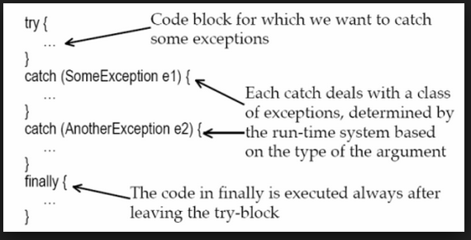
Try – catch - finally

Slide 16
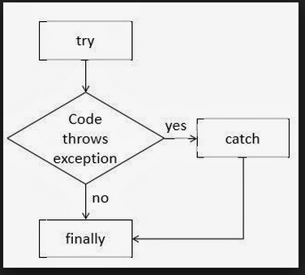
Try – catch – finally flow

Slide 17
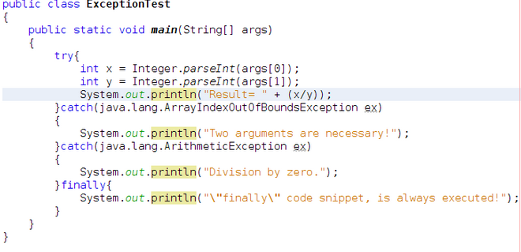
Example

Slide 18
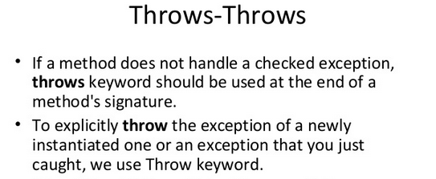

Slide 19
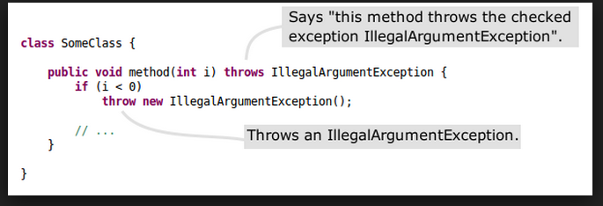
Throw and throws

Slide 20
User Defined Exceptions

Slide 21
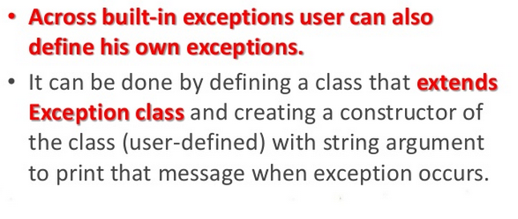
User Defined Exceptions

Slide 22
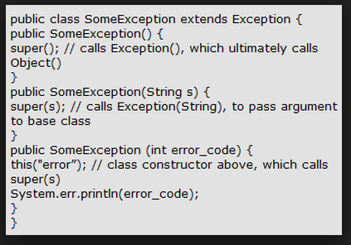
User Defined Exception

Slide 23
Java SE 7 Exception Changes
Multi-catch exceptions
try-with-resources

Slide 24
Nested Catch (Before 1.7)
public static void main(String[] args) {
try {
int a = Integer.parseInt(args[0]);
int b = Integer.parseInt(args[1]);
System.out.println("a/b = " + a/b);
} catch (NumberFormatException e) {
---
}
catch (ArrayIndexOutOfBoundsException e) {
---
}
catch (ArithmeticException e) {
---
}
}

Slide 25
Java 1.7
public static void main(String[] args) {
try {
int a = Integer.parseInt(args[0]);
int b = Integer.parseInt(args[1]);
System.out.println("a/b = " + a/b);
} catch (NumberFormatException | ArrayIndexOutOfBoundsException |
ArithmeticException e) {
System.out.println(" Please enter valid intigers");
}
}

Slide 26
Try-with-Resources
try (BufferedReader reader = new BufferedReader(
new InputStreamReader(
new URL("http://www.yoursimpledate.server/").openStream())))
{
String line = reader.readLine();
SimpleDateFormat format = new SimpleDateFormat("MM/DD/YY");
Date date = format.parse(line);
} catch (ParseException | IOException exception) {
// handle I/O problems.
}
Note : The resources ahead of time and the runtime automatically closes those resources (if they are not already closed) after the execution of the try block.

Slide 27
Exception Handling Best Practices

Slide 28
Use Specific Exceptions
Base classes of Exception hierarchy doesn’t provide any useful information, thats why Java has so many exception classes, such as IOException with further sub-classes as FileNotFoundException, EOFException etc.
We should always throw and catch specific exception classes so that caller will know the root cause of exception easily and process them.
This makes debugging easy and helps client application to handle exceptions appropriately.

Slide 29
Throw Early or Fail-Fast
We should try to throw exceptions as early as possible.
While debugging we will have to look out at the stack trace carefully to identify the actual location of exception.

Slide 30
Catch Late
Since java enforces to either handle the checked exception or to declare it in method signature, sometimes developers tend to catch the exception and log the error.
But this practice is harmful because the caller program doesn’t get any notification for the exception.
We should catch exception only when we can handle it appropriately.

Slide 31
Closing Resources
Since exceptions halt the processing of program, we should close all the resources in finally block.
We can use Java 7 try-with-resources enhancement to let java runtime close it for you.

Slide 32
Logging Exceptions
We should always log exception messages and while throwing exception provide clear message so that caller will know easily why the exception occurred.
We should always avoid empty catch block that just consumes the exception and doesn’t provide any meaningful details of exception for debugging.

Slide 33
Single catch block for multiple exceptions
Most of the times we log exception details and provide message to the user, in this case we should use java 7 feature for handling multiple exceptions in a single catch block.
This approach will reduce our code size and it will look cleaner too.

Slide 34
Using Custom Exceptions
It’s always better to define exception handling strategy at the design time and rather than throwing and catching multiple exceptions, we can create a custom exception with error code and caller program can handle these error codes.
Its also a good idea to create a utility method to process different error codes and use it.

Slide 35
Naming Conventions and Packaging
When you create your custom exception, make sure it ends with Exception so that it will be clear from name itself that it’s an exception.
Also make sure to package them like it’s done in JDK, for example IOException is the base exception for all IO operations.

Slide 36
Use Exceptions Judiciously
Exceptions are costly and sometimes it’s not required to throw exception at all and we can return a boolean variable to the caller program to indicate whether an operation was successful or not.
This is helpful where the operation is optional and you don’t want your program to get stuck because it fails.

Slide 37
Questions???
DEMO

